Slide 1
COE Advising Copilot (Configured + Published on Existing Copilot Platform)
EECS

Slide 2
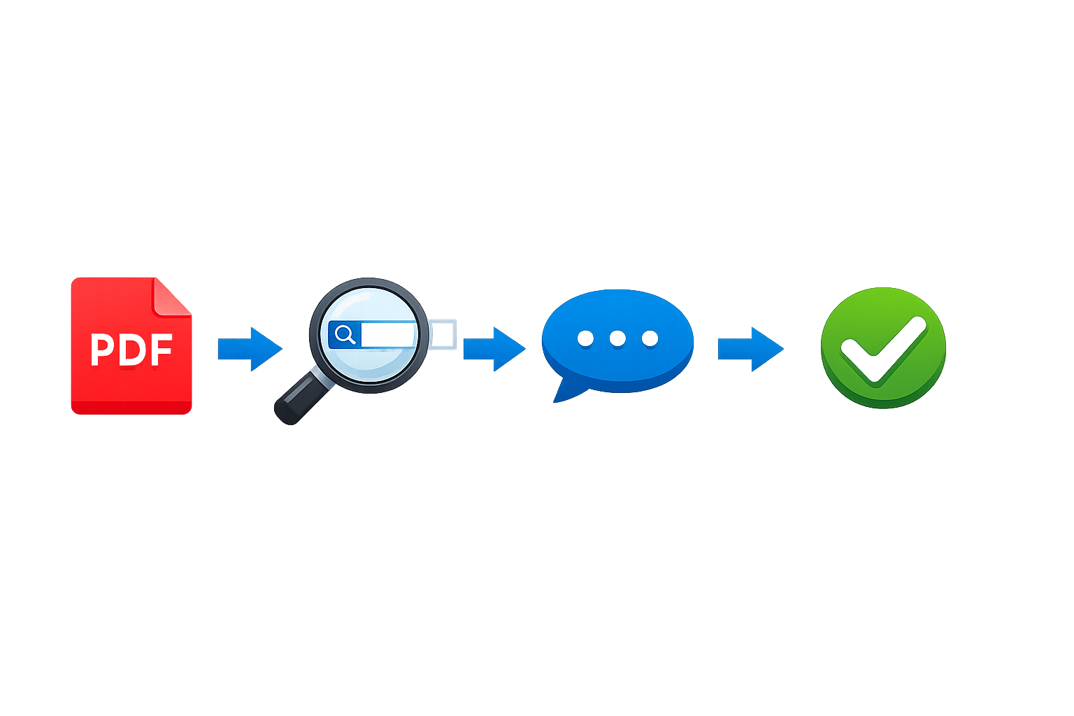
Retrieval-grounded chatbot that answers student questions using Academic Advisors' approved advising docs

Slide 3
What we are and aren’t building
Goals
Consistent responses + citations to sources
Safe fallback when info is missing/ambiguous
Easy updates as policies change
A governed COE-wide copilot instance that stays aligned with COE policy updates
Non-goals
Not a decision-maker for petitions
Not handling personal-sensitive student records
Not replacing LionPATH or official degree audit
Training or replacing the copilot model

Slide 4
Proposed solution: Configure Copilot with COE-approved knowledge + guardrails
Use existing Copilot platform features:
Knowledge ingestion: Pain Point Pack + COE advising PDFs
Retrieval + citations: responses link back to source sections
Guardrails: “allowed response” + safe fallback
Publish to COE audience (scoped access)

Slide 5
Guardrails: “Allowed response” + default fallback
“Allowed response” is implemented as:
response templates + system rules
citation requirement
refusal/escalation logic when unsupported
“Default response” includes:
“I can’t confirm from approved COE docs…” + routing guidance

Slide 6
Implementation: Copilot configuration workstreams
Content readiness: clean PDFs and PPTXs, chunking-friendly formatting, metadata tags (doc type, owner, date)
Copilot knowledge setup: upload/connect sources, scope collections by topic
Prompting + response policy: allowed response rules + tone
Publishing + permissions: COE groups, role-based access

Slide 7
Deployment: Copilot platform + COE knowledge sources
Users (Students / Advisors / Staff)
COE Copilot (existing platform)
Approved Knowledge Sources (Pain Point Pack + COE advising PDFs)
Access Control / Authentication (PSU accounts)
Logging/Analytics
Feedback channel
We are configuring and publishing, not hosting the infrastructure.

Slide 8
Technical evidence to date
Ingestion working on initial PDF set (X docs, Y pages)
Retrieval returning relevant sections for common scenarios
Copilot answers include citations to COE docs
Common question types show consistent policy phrasing

Slide 9
Evaluation plan (what we’ll measure)
Some Test sets i.e. scenarios written by advisors/team
Retrieval correctness
Citation validity rate (answer claims supported by citations)
Fallback appropriateness rate (did it refuse when it should?)
We are evaluating the copilot configuration, not training a model.

Slide 10
Roadmap + guidance request
Roadmap: Pilot (single unit) → COE internal release → COE publish
Questions for you, Professor:
Are we scoping the right document set and question types?
What “failure modes” should we prioritize?
Any must-read related work we should cite?
Should we pursue a small pilot in one advising unit first?

Slide 11
THANK YOU!

